Slide 1
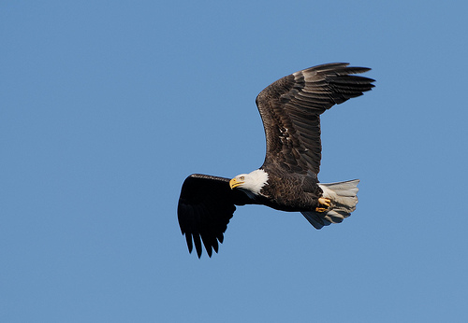
Learning About Raptors

Slide 2
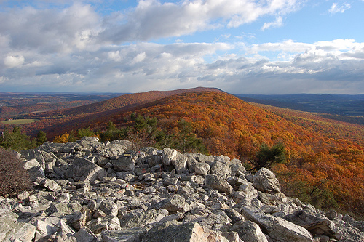

The world’s first raptor refuge

Slide 3
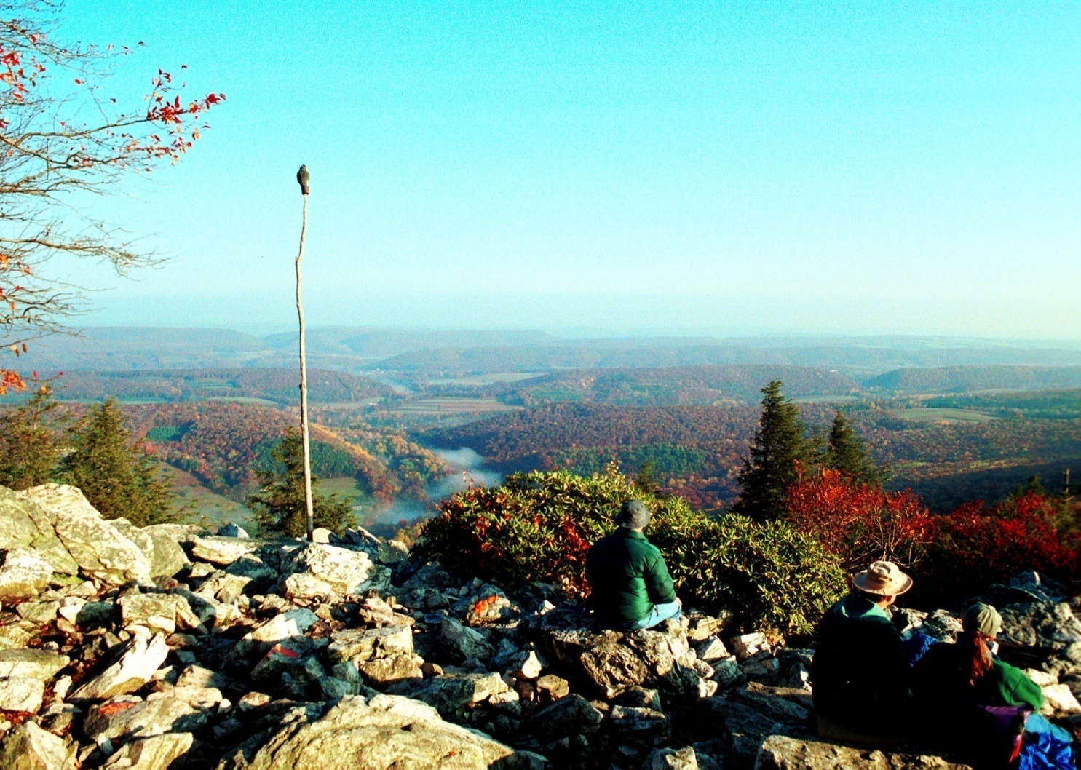
Located on top of a mountain ridge in eastern Pennsylvania

Slide 4
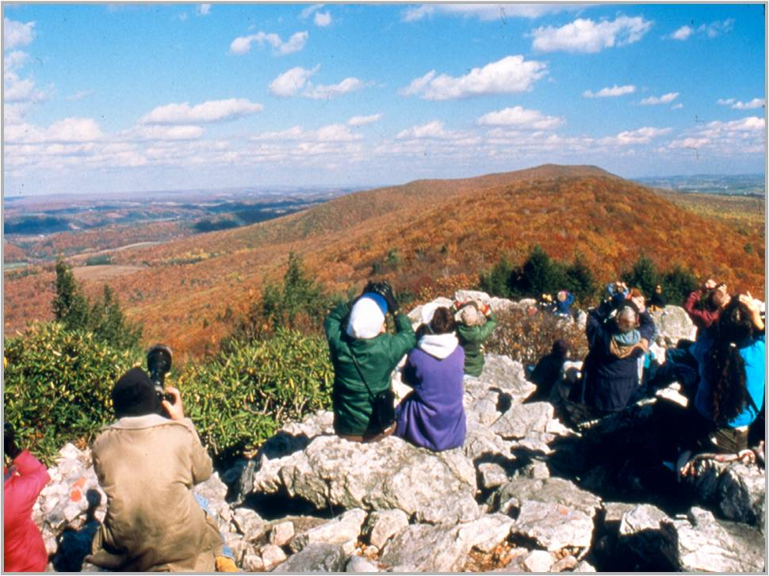
Hawk Mountain is a great place to watch migrating raptors.

Slide 5
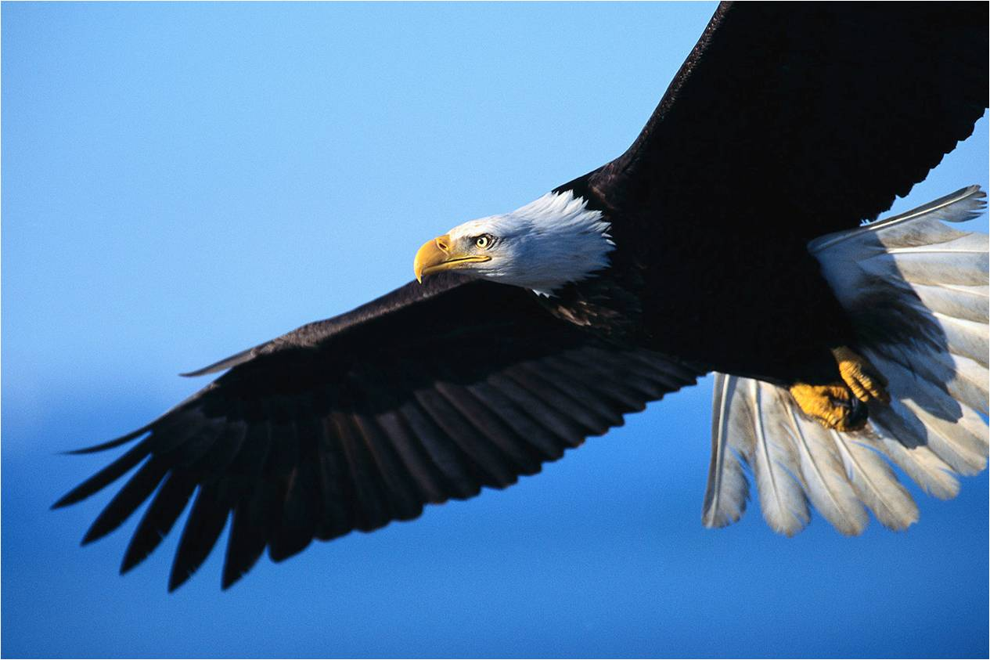
Part One
Raptors

Slide 6
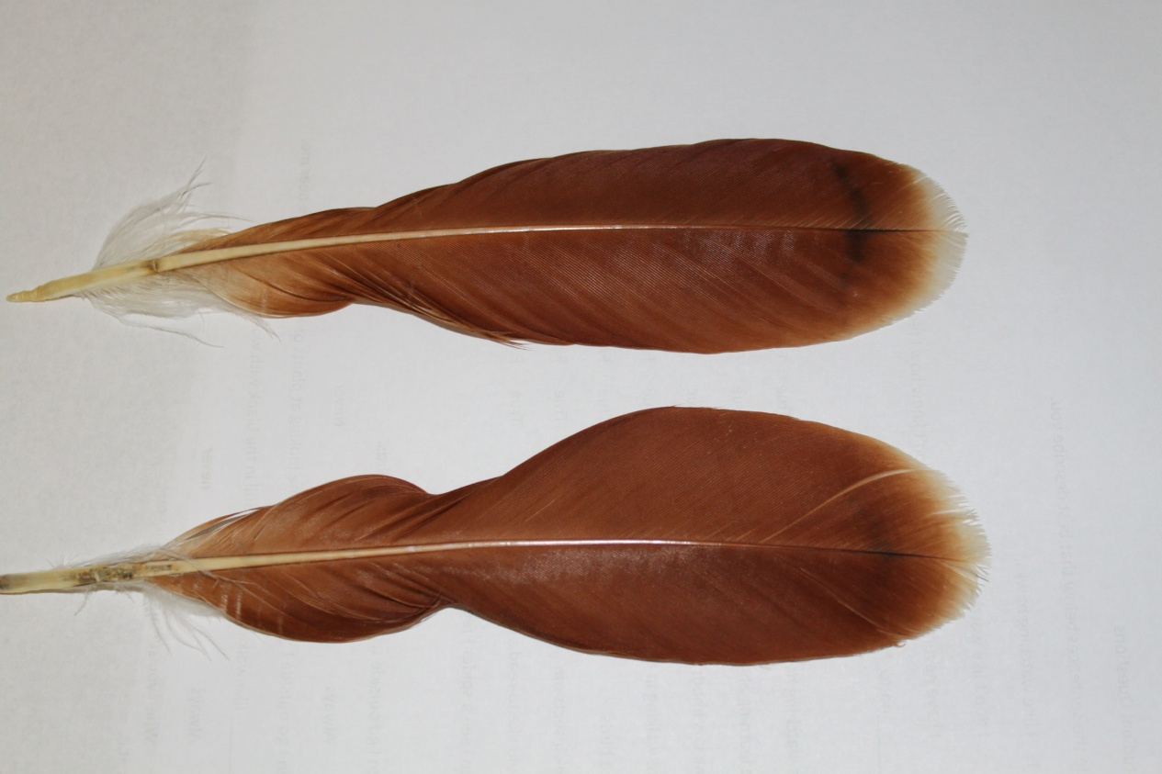
What is a Raptor?
A kind of bird
Because it has feathers
Birds are the only animals with feathers

Slide 7
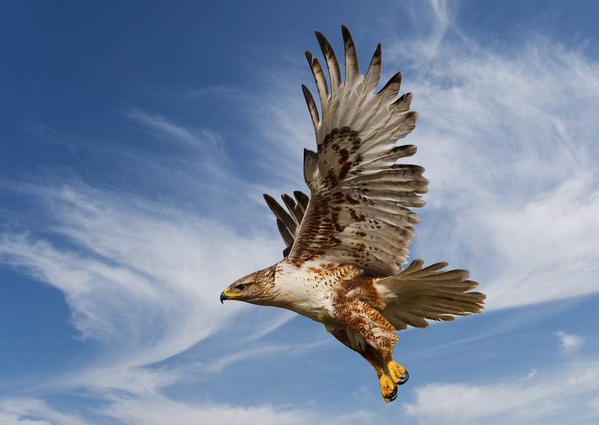

Raptors are predators that eat smaller animals called prey.
They catch and kill them with their feet.

Slide 8
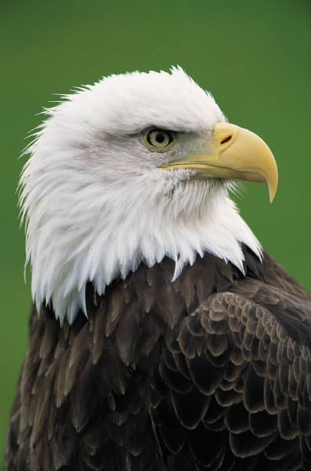
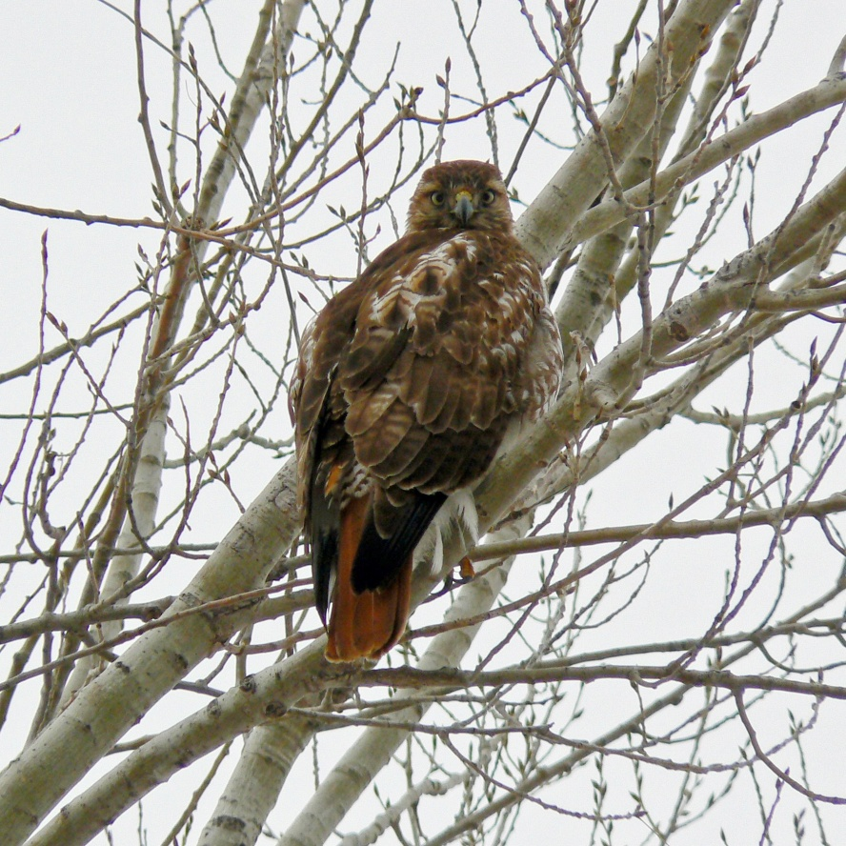
Kinds of Raptors
Eagles
Hawks
Bald Eagle
Red-tailed Hawk
Eat mostly fish, found near water
Very common, adults easily identified by red tail

Slide 9
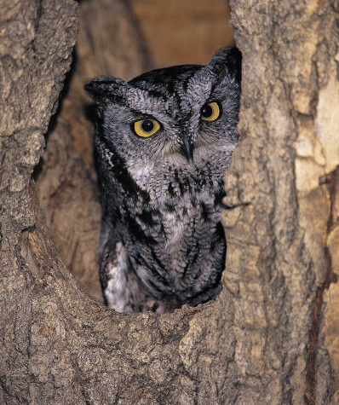
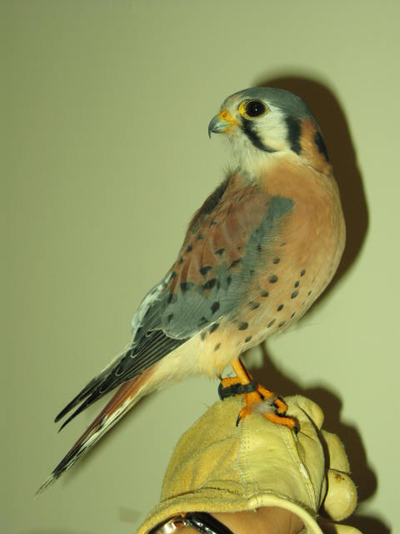
Kinds of Raptors
Owls
Falcons
American Kestrel
Eastern Screech Owl
Most owls are nocturnal or active at night
Smallest North American falcon

Slide 10
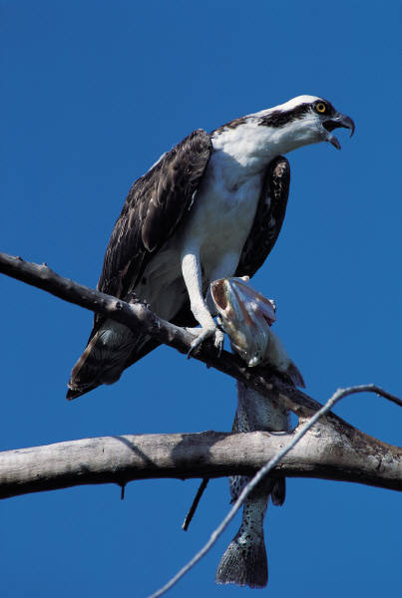
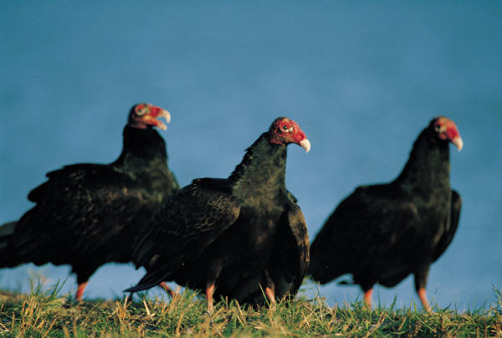
Kinds of Raptors
Osprey
Vultures
Turkey Vulture
Lives near water and eats mainly fish
Scavengers that eat dead animals

Slide 11
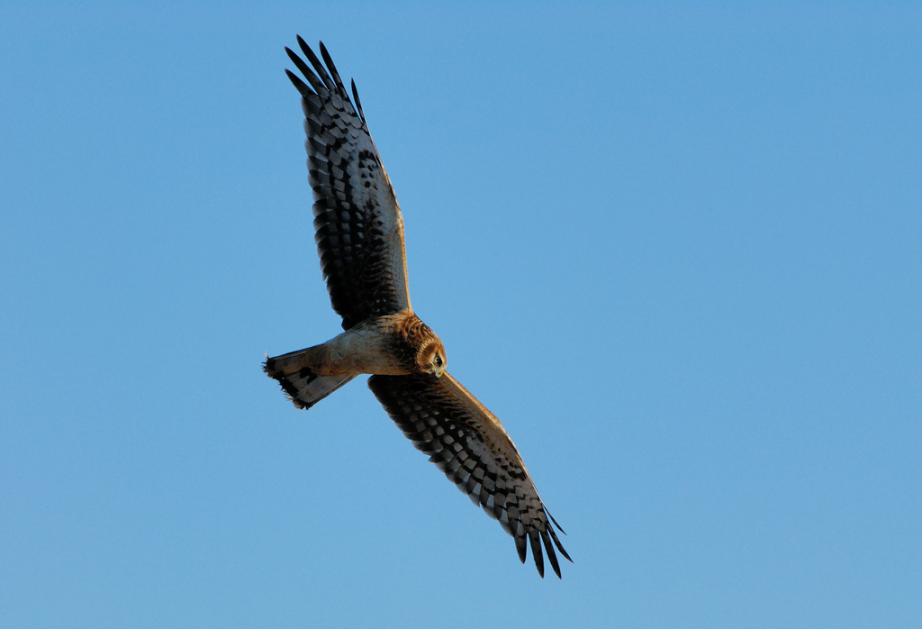
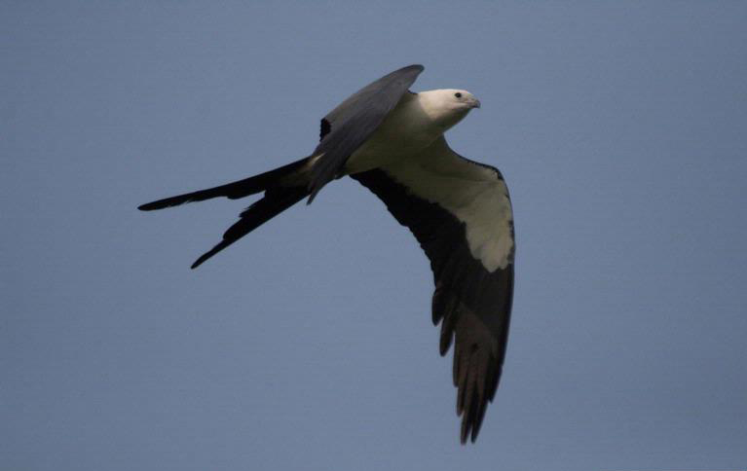
Kinds of Raptors
Harriers
Kites
Northern Harrier
Swallow-tailed Kite
Low flying hunters of open fields and marshes
Hunts insects on the wing

Slide 12
What have you learned?
Can you name two kinds of raptors?

Slide 13
Major Groups of Raptors
Eagles
Hawks
Falcons
Vultures
Osprey
Owls
Harriers
Kites

Slide 14
Part Two
Adaptations

Slide 15
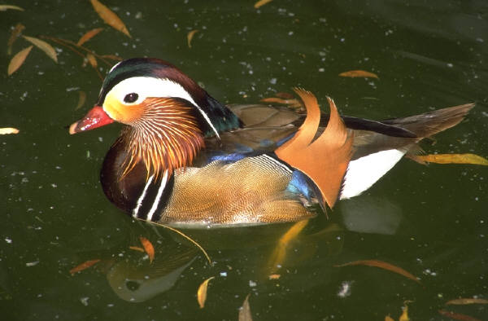

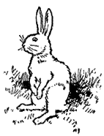
Amazing Adaptations
Animals have adaptations that help them to survive
Webbed feet help ducks swim
Big ears help rabbits hear danger

Slide 16
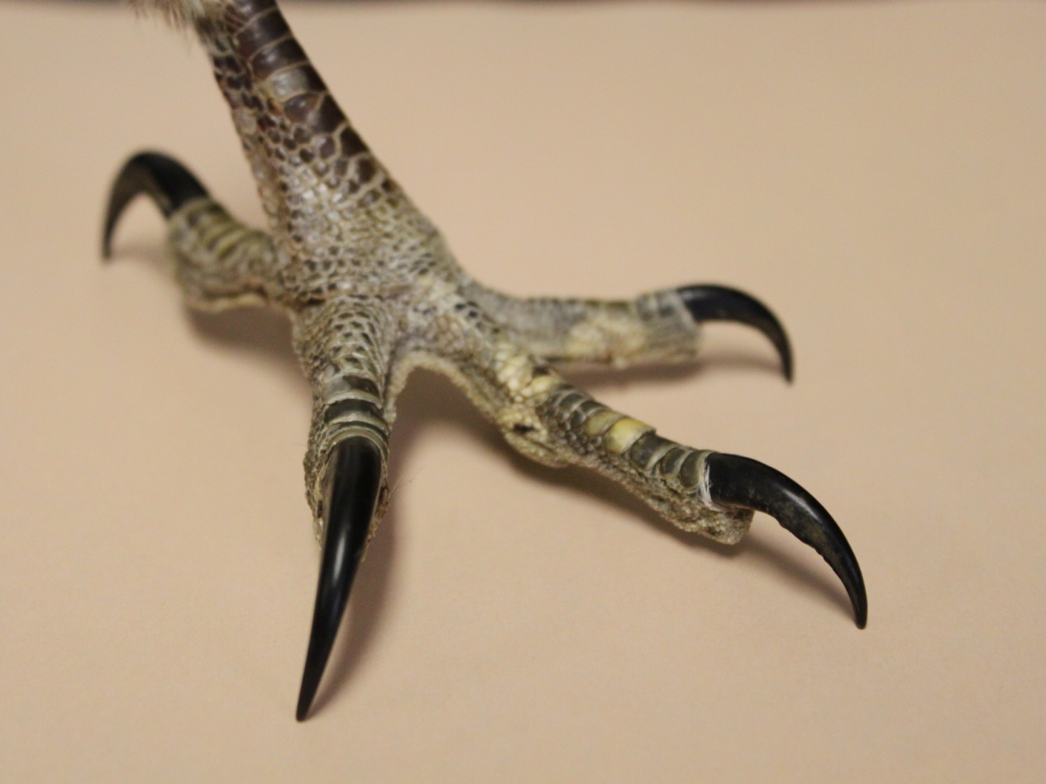
Fabulous Feet
Raptor Adaptations
Talons
Raptors have sharp, curved claws called Talons.
Used to catch, hold, and kill prey

Slide 17
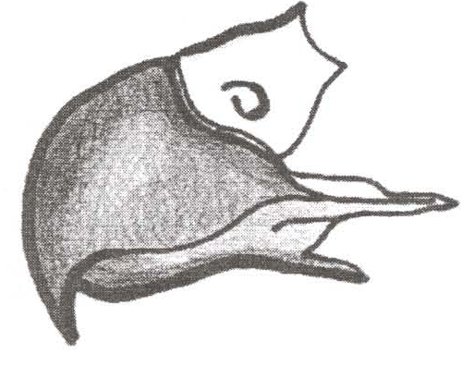
Unique Beak
Raptor Adaptations
Raptors have a hooked beak with sharp edges
Used to cut their food into small pieces

Slide 18
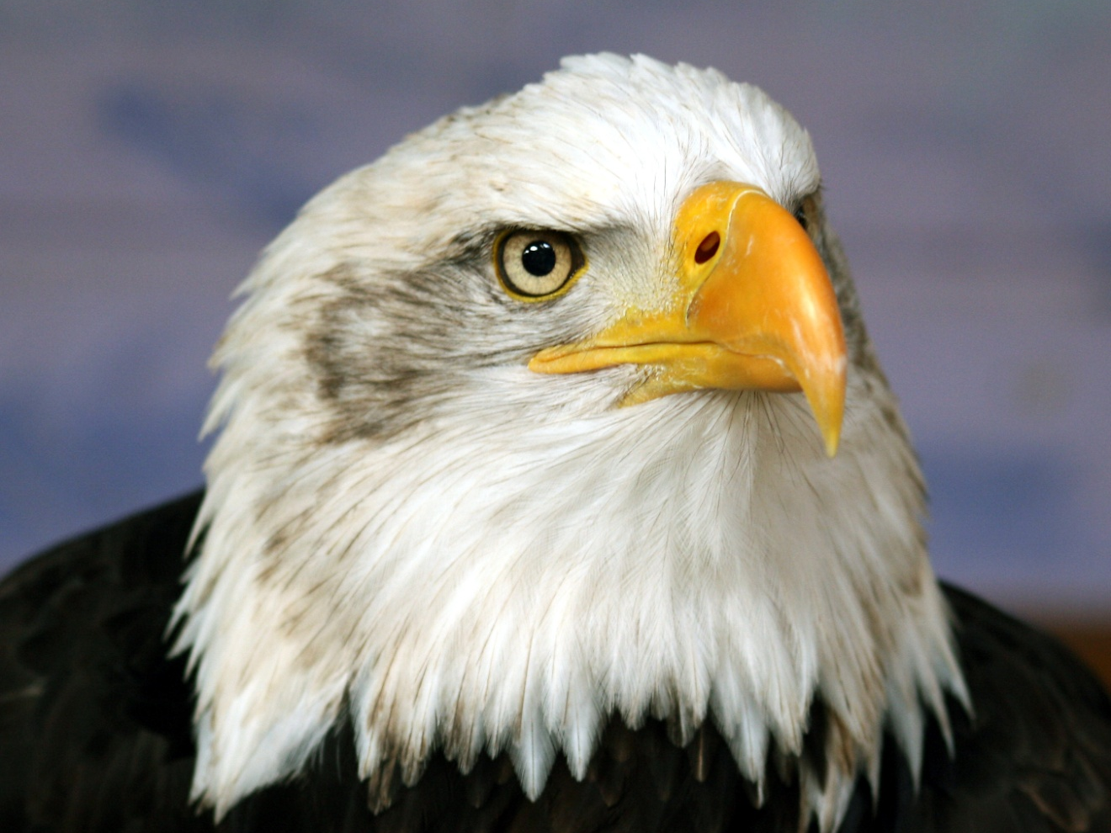
Awesome Eyes
Raptor Adaptations
Raptors have very good eyesight
Used to look for prey from far away

Slide 19
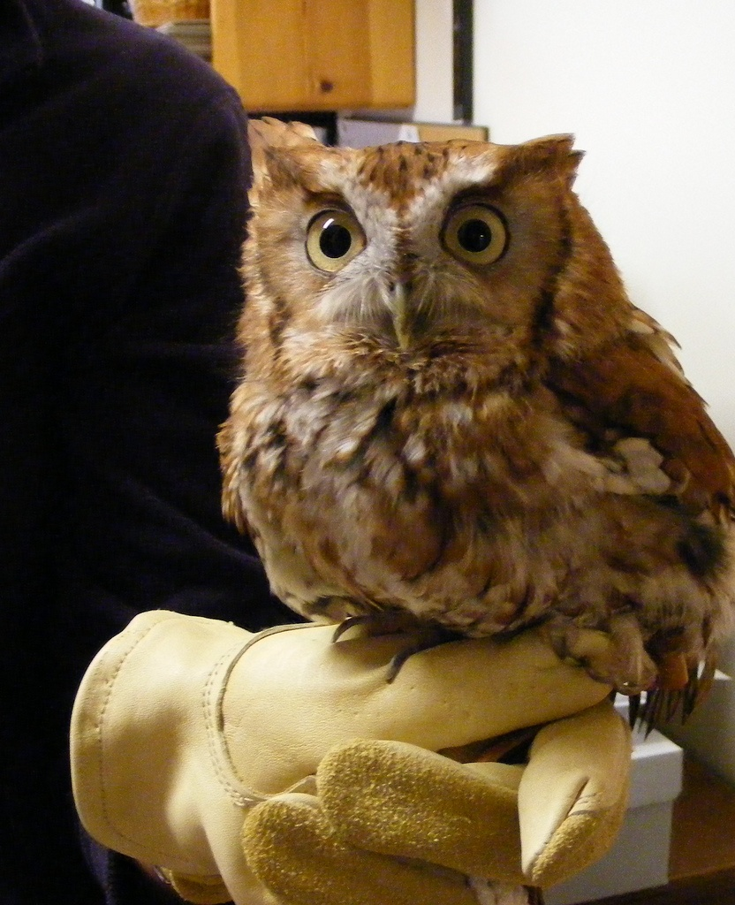
Raptor Adaptations
Super Hearing
Owls have very good hearing for finding prey at night
Notes:
Barn owl

Slide 20
What have you learned?
Name two adaptations of raptors

Slide 21
Raptor Adaptations
Talons: for catching and killing prey
Hooked beak: for ripping up prey
Great eyesight: for seeing prey from far away
Good hearing: for finding hidden prey

Slide 22
Part Three
Food Chains

Slide 23
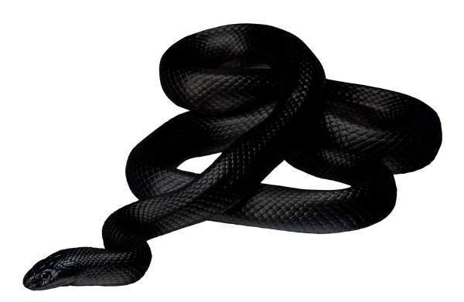
What do raptors eat?
Small to medium-sized animals
Animals that eat other animals are called carnivores

Slide 24
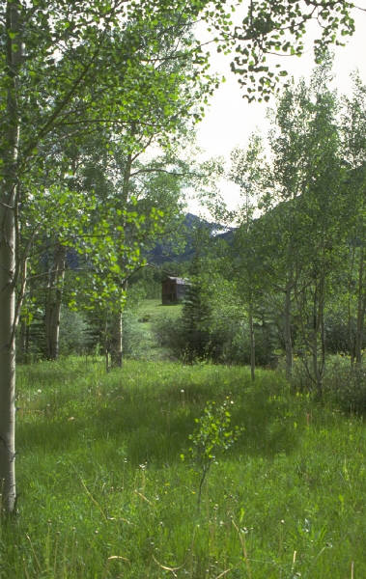
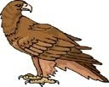


All raptors are part of a food chain
Energy
Energy
Energy
Sun Plants Animals Raptors
plants use the sun’s energy to grow
animals get energy from eating plants or animals

Slide 25

All links in the chain are important
Energy
Energy
Energy
Sun
Plants
Animals
Raptors
If raptors were gone there might be too many mice
What might happen if all the mice were gone?

Slide 26
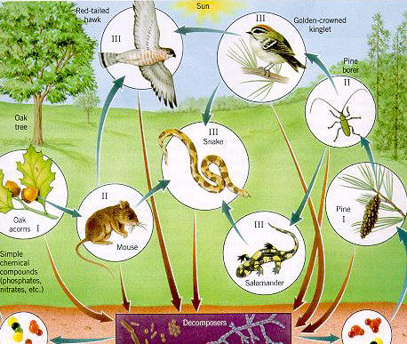
Raptors help maintain a balance in nature

Slide 27
What have you learned?
Can you name three things a raptor would eat?

Slide 28
What Raptors Eat
Mammal
Insect
Bird
Reptile
Fish
Amphibian

Slide 29
Part Four
Migration

Slide 30
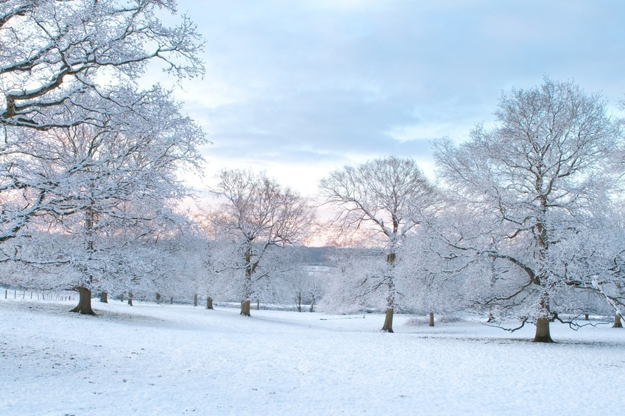
Raptors in Winter
It is hard for raptors to find food in winter
Animals die or sleep, fish are under ice

Slide 31
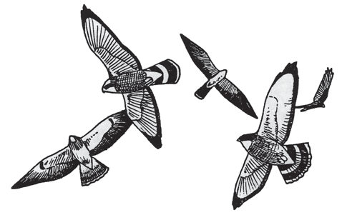
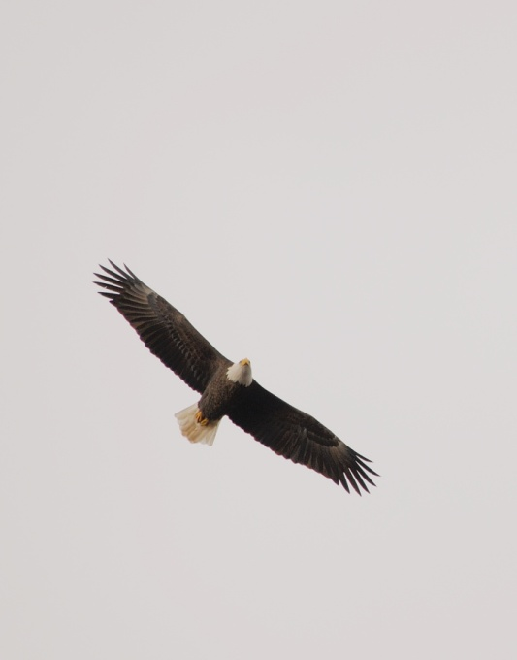
Time to fly - Migration
Many raptors fly south to a warmer place
They can find more food there
When winter is over they return
This annual trip south and back again is called migration

Slide 32
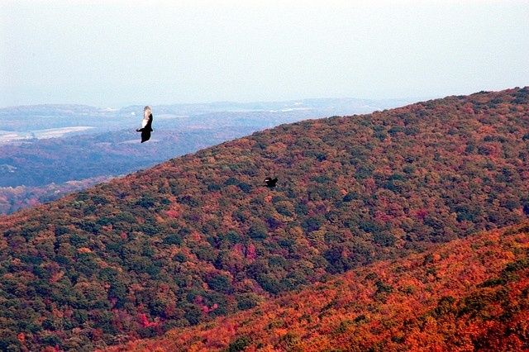
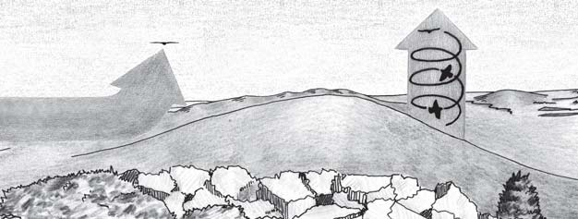
Migrating raptors follow mountain ridges
Rising air lifts the birds so they save energy when flying
updraft
thermal
lift
wind
Hot air

Slide 33
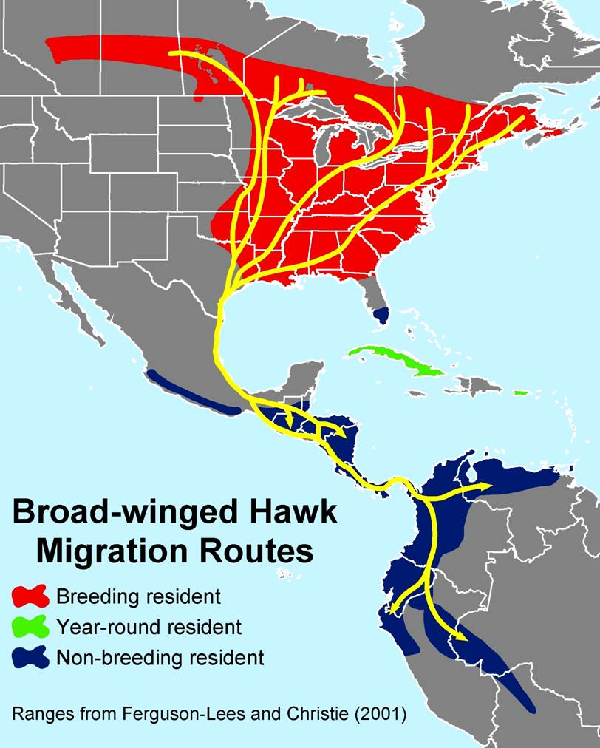
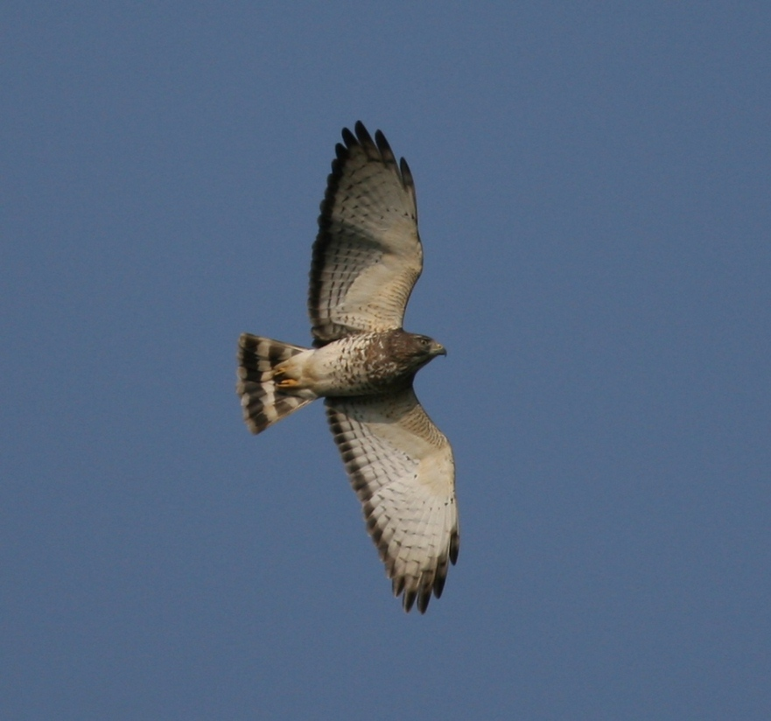
Some birds fly from
North America
to South America
North America
Hawk
Mountain
Puerto Rico
Mexico
Dominican Republic
South
America
Broad-winged Hawk

Slide 34
What Have You Learned?
1. Why do birds migrate south for the winter?
2. Why can you see many raptors migrating at Hawk Mountain Sanctuary?

Slide 35
1. To find food
2. Raptors follow mountain ridges when they migrate. Rising air currents help them save energy while flying.

Slide 36


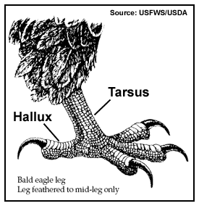
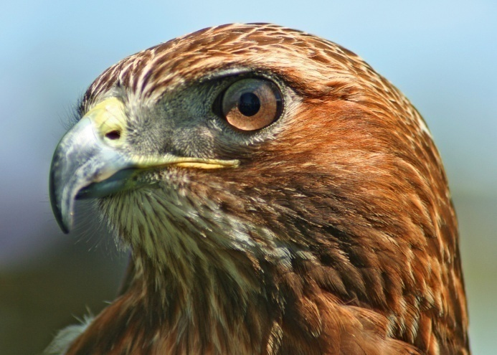
Some things to think about
Do raptors live near you? Where would you look for one?
What kinds of animals could a raptor eat in your neighborhood?
What do you think of raptors?

